Slide 1
EPL646: Advanced Topics in Databases
CAPER : A Cross-Application Permissioned Blockchain
Mohammad Javad Amiri, Divyakant Agrawal, and Amr El Abbadi. 2019. . Proc. VLDB Endow. 12, 11 (July 2019), 1385–1398. DOI: https://doi.org/10.14778/3342263.3342275
By : Erodotos Demetriou (edemet01@cs.ucy.ac.cy)
https://www.cs.ucy.ac.cy/~dzeina/courses/epl646

Slide 2
Introduction
BLOCKCHAIN TECHNOLOGY
Blockchain (BC) is a distributed data structure for recording transactions maintained by nodes without a central authority.
It provides Transparency, Provenance and Authenticity.
Bitcoin was the first application to run on Blockchain. Nowadays we want to run a range of distributed applications on blockchains and even use multiple chains to make achieve cross-application transactions.
Decentralized applications require a high performance in terms of throughput and latency.
Prev. Block Hash
Cur. Block Hash
TX {….}
Sample Block
Bitcoin = Public Permissionless BC = Low Throughput & Latency = 5 TPS , about 60 min to add a new TX to the ledger
https://www.cs.ucy.ac.cy/~dzeina/courses/epl646

Slide 3
Introduction
Private / Permissioned Blockchains were proposed to overcome the Bitcoin’s bottleneck and scale to world demands
Closed ecosystem
Only cetrified entities can run a Node
Inexpensive consensus algorithms
Scalable solutions
Only approved parties can join the blockchain (permissioned)
Paper authors propose a new Blockchain solution called CAPER.
It is Private and tries to solve cross-application transaction bottlenecks using different consensus algorithms.
Compare results with Hyperledger Fabric
https://www.cs.ucy.ac.cy/~dzeina/courses/epl646

Slide 4
Background and Motivation
Current execution model
ORDER – EXECUTE
Firstly, all nodes agree on a total order of the blocks (blocks contains transactions) using consensus protocols and finally all transactions are executed in the same order sequentially, on all nodes. Obviously this method has low performance in terms of throughput and & latency.
Fabric execution model
EXECUTE – ORDER - VALIDATE
Hyperledger Fabric has an optimistic approach. First executes all transactions in parallel without ordering them. After that there is a separate ordering service which pack transactions into blocks and distributes them to all nodes. Finally, all nodes can validate transactions according to the blocks they have received.
https://www.cs.ucy.ac.cy/~dzeina/courses/epl646

Slide 5
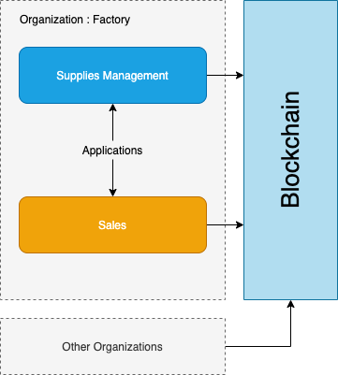
Background and Motivation
Application is the business logic running on the blockchain.
On a modern blockchain we may have multiple applications running on the same blockchain with the use of smart contracts.
An Application can run on multiple organizations
Applications across different organizations can communicate.
Applications interact with the blockchain submitting transactions
https://www.cs.ucy.ac.cy/~dzeina/courses/epl646

Slide 6
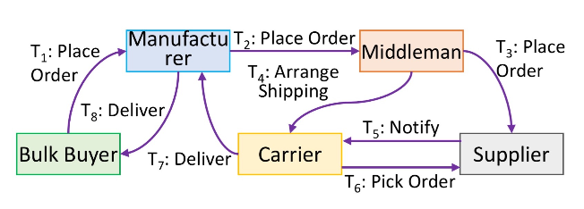
Background and Motivation
In the modern world we want to involve multiple parties to a blockchain system. Some parties are interested in some transaction while the others are not. So we have 2 types of transactions : Cross-Application and Internal.
Supply chain example :
T1: BB Place Order to M
T2: M Place order to Mid
T3 : Mid Place Order to S
T4 : Mid Arrange Shipping with C
T5 : S notify C
T6 : C picks order from S
T7 : C Delivers to M
T8 : M Delivers product to BB
Manufacturer might want to use the blockchain for internal auditing. For example calculating materials demand
Cross – Application TX
Internal TX
https://www.cs.ucy.ac.cy/~dzeina/courses/epl646

Slide 7
Background and Motivation
Solution #1
Use a single blockchain where all transactions will be maintained. This blockchain ledger will be replicated to all peers
Drawbacks This is not a viable solution as internal transactions concept is not satisfied
Solution #2
An other solution is to implement each application on a different blockchain. This is good for parallel processing of different transactions
Drawbacks What if applications want to exchange data from different BCs? This is too expensive.
https://www.cs.ucy.ac.cy/~dzeina/courses/epl646

Slide 8
The CAPER Model
Each Application maintains two sets of records
Private data can only be accessed by the application
Private records
Public records
Public data can only be accessed by everyone
Internal Transactions
This txs usually perform inner calculations. The internal transactions can write on the private records but only read the public
Cross – Application Transactions
Cross – Application transactions follow the Service Level Agreements to emit public records. They can update public records as well.
CAPER supports two types of smart contracts :
Public
Private
Note : A smart contract is similar to a database trigger. In other words, some actions are taken when certain conditions are met.
https://www.cs.ucy.ac.cy/~dzeina/courses/epl646

Slide 9
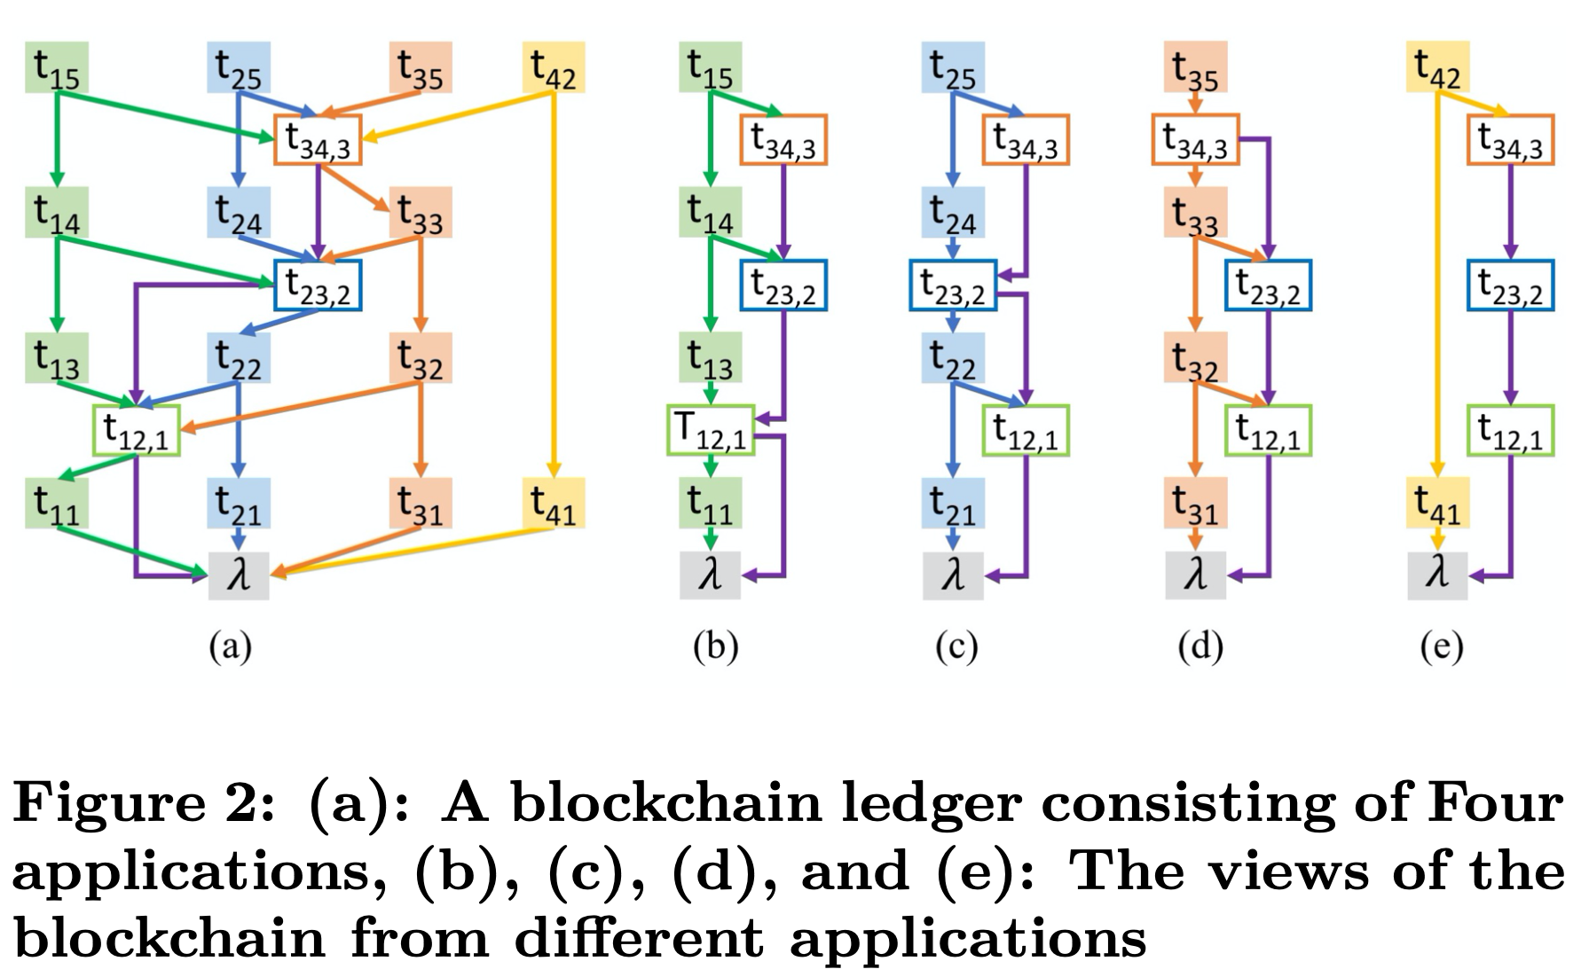
The CAPER Model
Batching Transactions
Ledger Properties
Use of DAG
There is total order between all transactions.
There is total order between cross-application transactions.
An internal transaction of an application might include the cryptographic hash of a cross- application transaction
Batching transactions into blocks reduce performance. For this reason, a block in CAPER has only one transaction
https://www.cs.ucy.ac.cy/~dzeina/courses/epl646

Slide 10
The CAPER Architecture
Applications run on nodes that we call agents
Nodes are connected using bidirectional point-to-point communication channels.
Each message contains public key signature and message digest. This helps to check if the message has been changed.
Nodes in CAPER might crash, behave maliciously or be reliable.
Trust levels (Even if the agents of an application are crash-only nodes, the application might still behave maliciously) :
Node level
Application level
Consensus algorithm must satisfy the properties :
Safety : all correct nodes receive the same requests in the same order
Liveness: all correct client requests are eventually ordered.
PBFT
Paxos
This protocol is introduced when we suspect the presence of malicious node. We need 3f+1 nodes to guarantee safety.
It is better to use in systems where node crash is most likely to occur. We need 2f+1 nodes to guarantee safety.
https://www.cs.ucy.ac.cy/~dzeina/courses/epl646

Slide 11
Local Consensus on CAPER
Local Consensus is used to order and execute internal transactions. The local consensus can use PBFT or Paxos
Client Request | Client sends a request for an internal transaction for an application by sending a message to the agent that believes to be the primary(only the primary agent can initiate the transaction)
Consensus Initiation | When primary receives the request checks the signature of the message to ensure that is valid. After that it initiate the consensus algorithm.
Execute TX | When the algorithm is executed and finally all agents/nodes come to an agreement, the transaction is eventually executed and a new block is appended to the blockchain.
Reply to client | Finally, a response is returned to the client, stating the execution result and the execution timestamp.
https://www.cs.ucy.ac.cy/~dzeina/courses/epl646

Slide 12
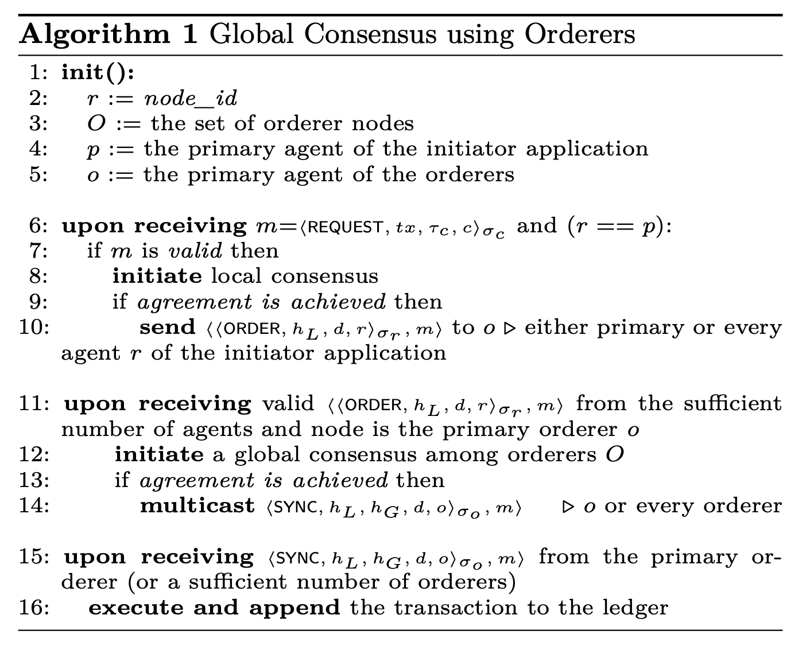
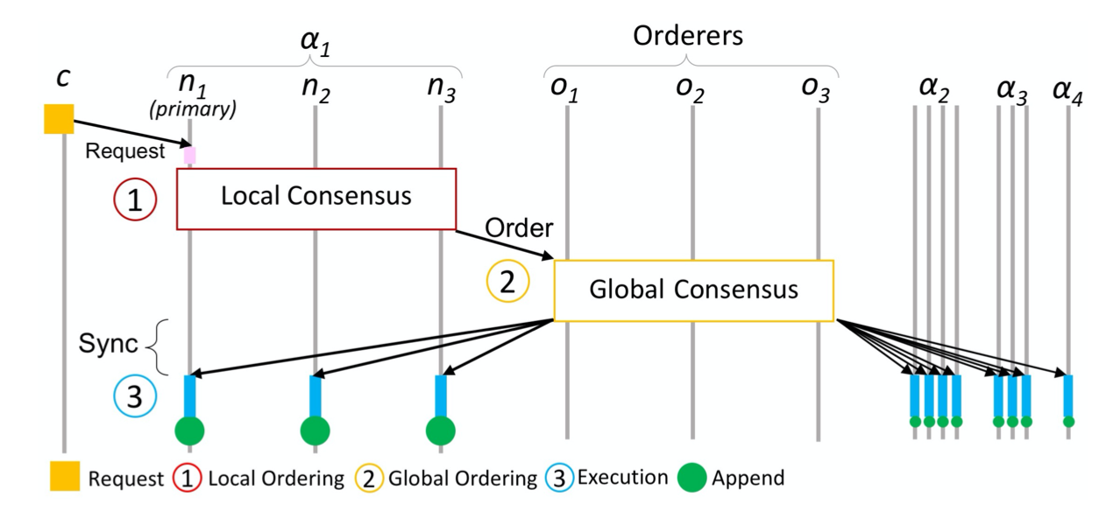
Global Consensus – using seprate ordering service
In this scenario we use a disjoint group of ordering nodes ( like Hyperledger Fabric Implementation). The approach requires a set of different orders for each application
https://www.cs.ucy.ac.cy/~dzeina/courses/epl646

Slide 13
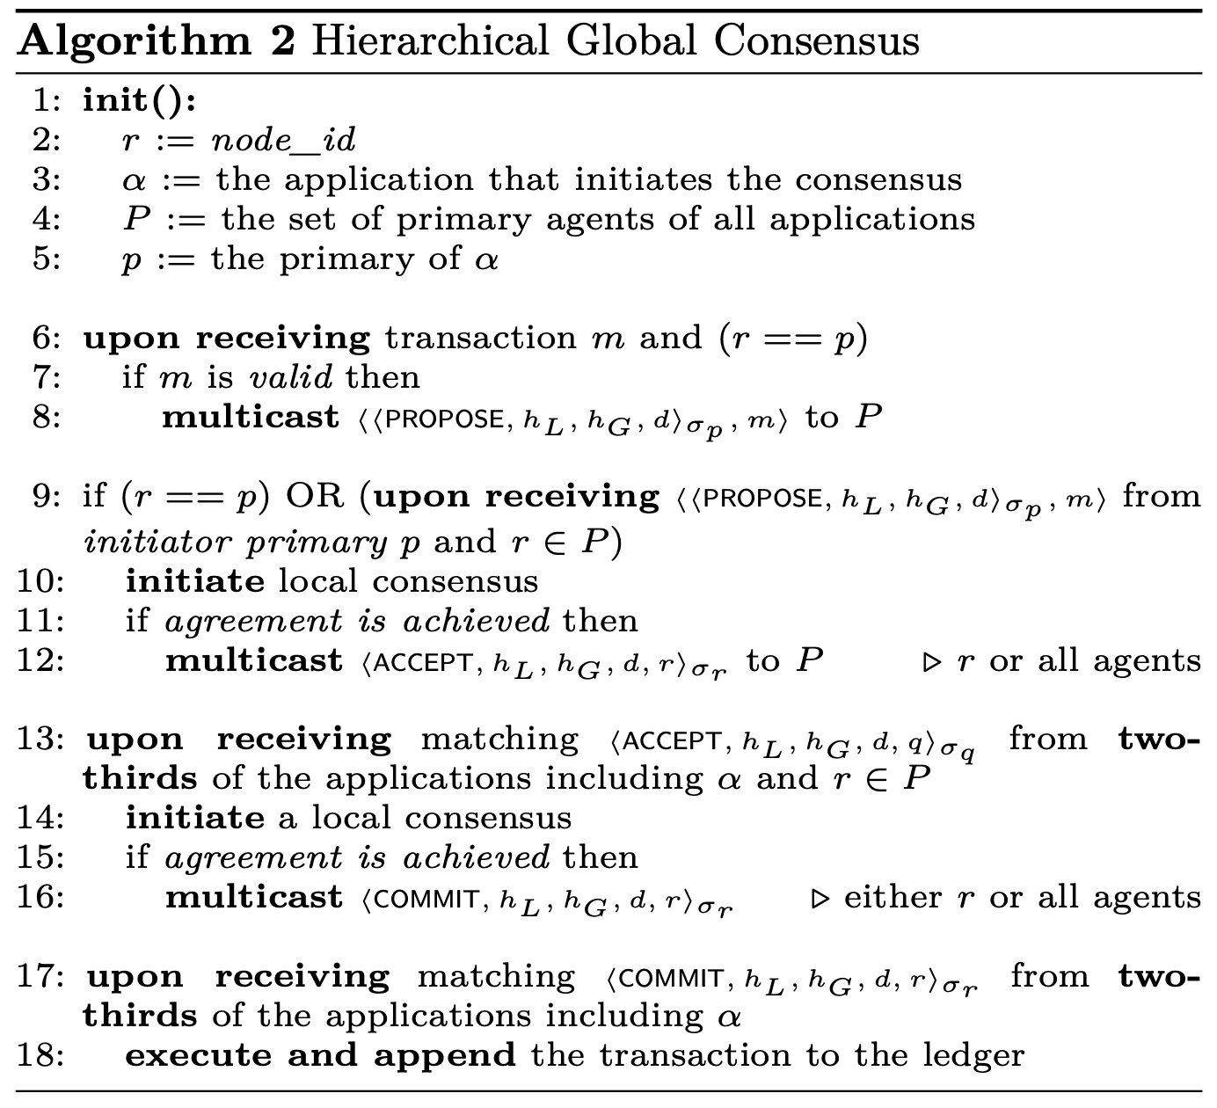
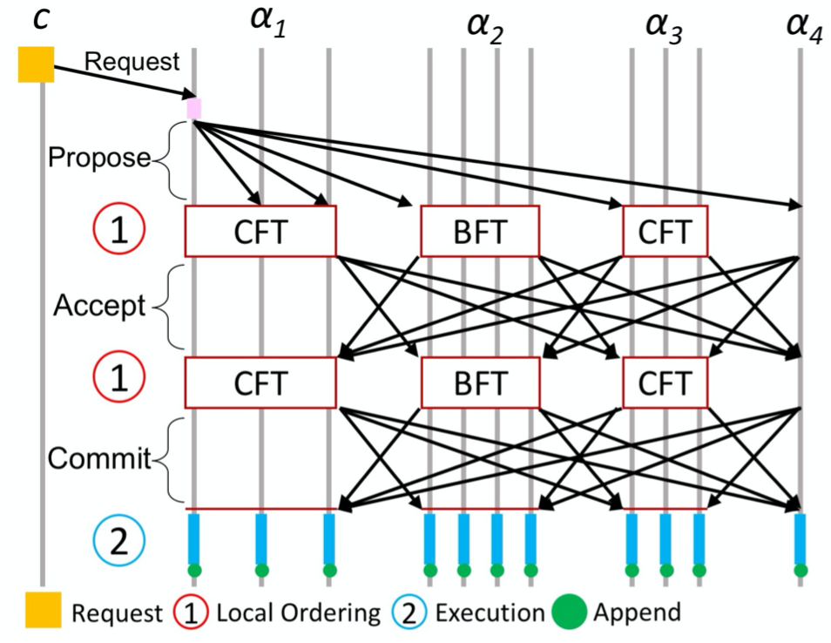
Global Consensus – Hierarchical
The previous scenario which use external ordering service is a very good and scalable solution. Though, using this structure comes with extra cost. This scenario describes a 2 level consensus
https://www.cs.ucy.ac.cy/~dzeina/courses/epl646

Slide 14
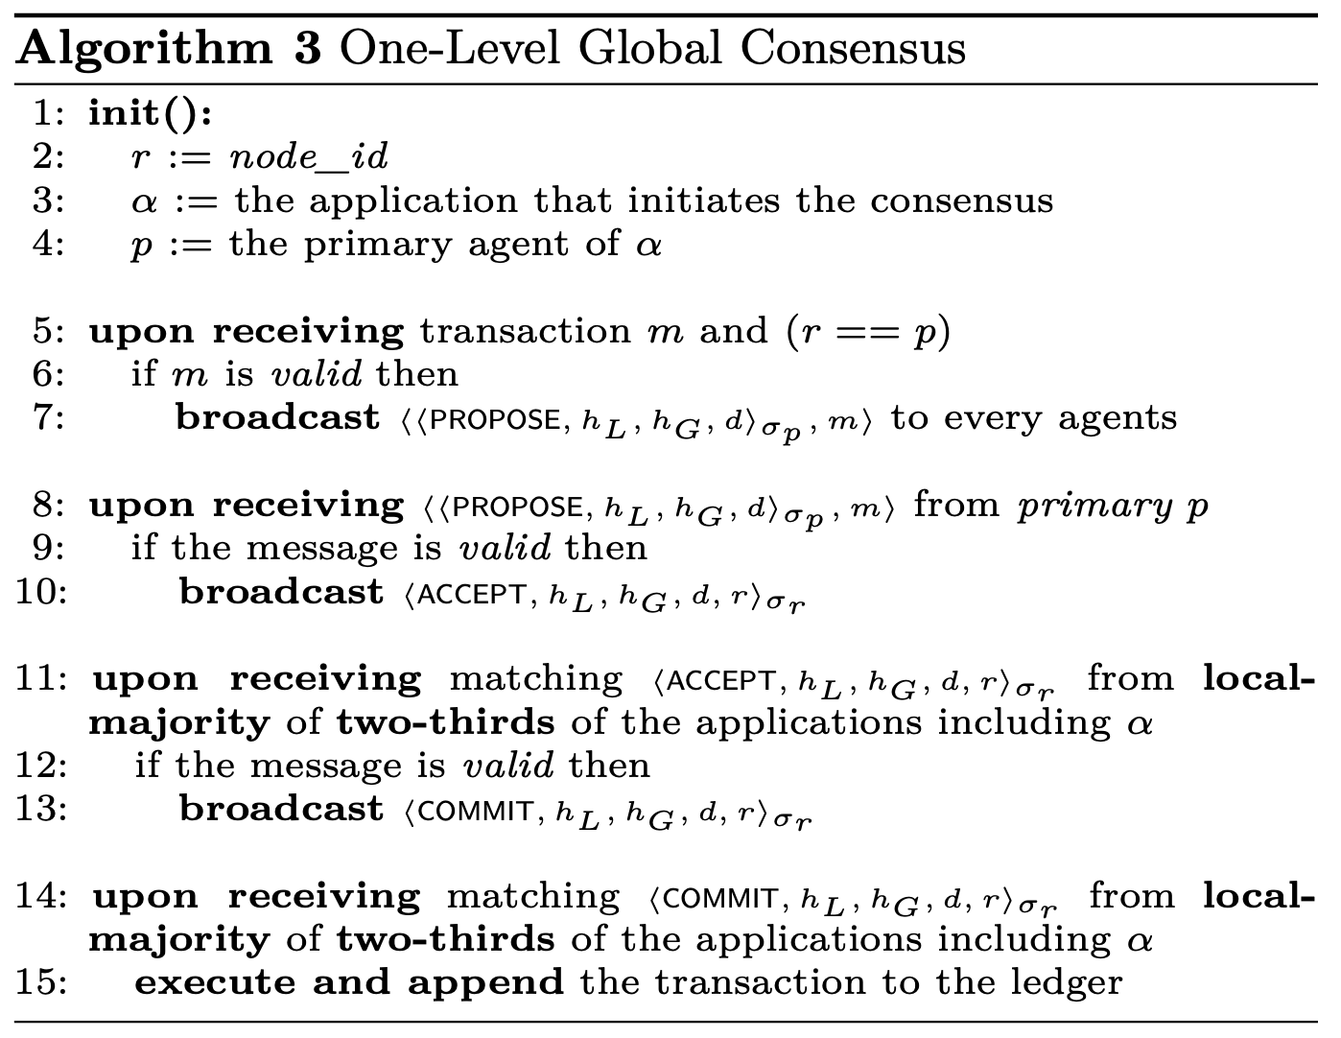
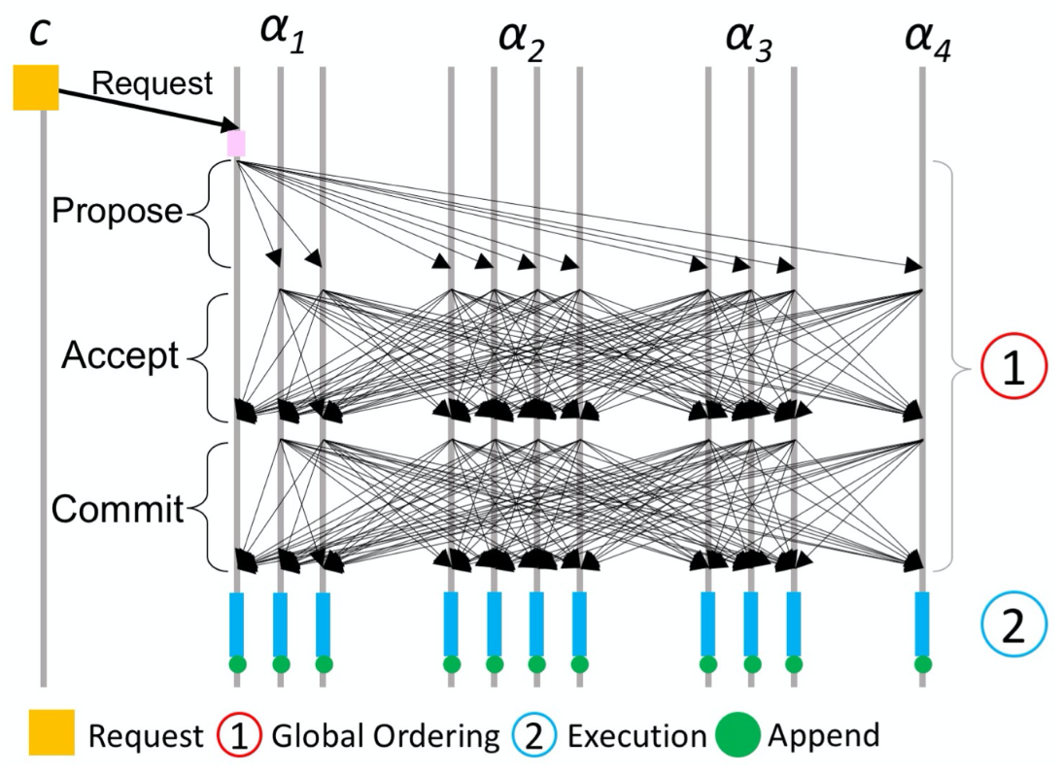
Global Consensus – One-Level
Two level consensus is expensive. For this reason in this scenario we explore a one-level global consensus algorithm
https://www.cs.ucy.ac.cy/~dzeina/courses/epl646

Slide 15
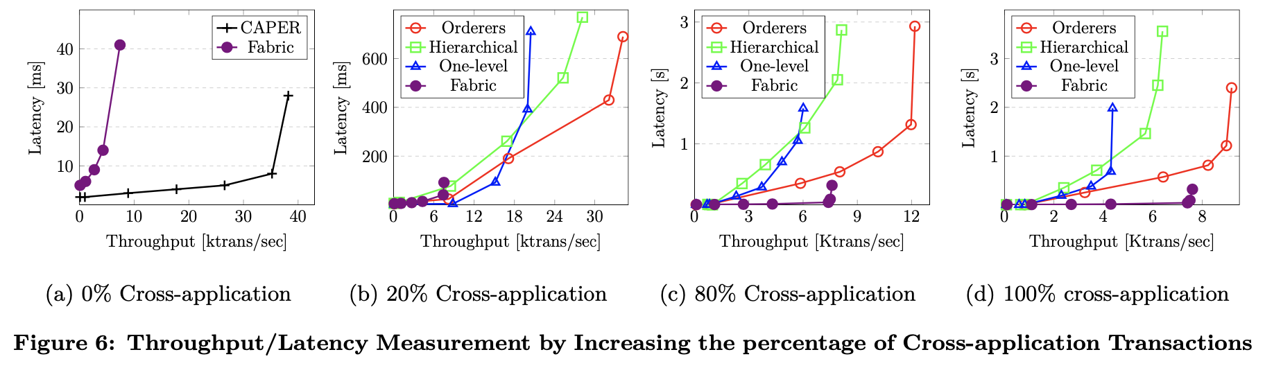
Experimental Evaluations
NOTE : Hyperledger Fabric has an upper limit on the transaction throughput which is 7000. This is due to the execution model – execute-order-validate. Because of this approach a lot of transactions are eventually invalid.
https://www.cs.ucy.ac.cy/~dzeina/courses/epl646

Slide 16
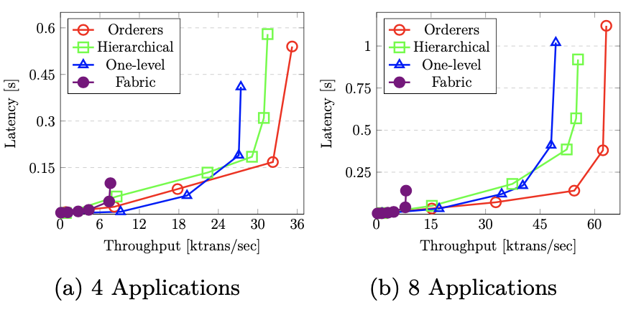
Experimental Evaluations
Notes : For each deployment, we consider workloads with 90% internal and 10% cross-application transactions.
In Fabric, increasing the number of applications does not significantly improve the performance. Fabric can have a high number of applications with the same performance.
Using orderers consensus in CAPER has better performance than one-level and hierarchical for a higher volume of transactions.
For workloads with less than 20000 txs one-level consensus is better.
Increasing the number of applications, results in higher latency for the same throughput in both one-level and hierarchical consensus due to the increase number of nodes.
https://www.cs.ucy.ac.cy/~dzeina/courses/epl646

Slide 17
Conclusion
CAPER is permissioned blockchain
Supports both internal and cross-application transactions
CAPER targets both performance and confidentiality
Blockchain ledger is not maintained by any node and each application maintains its own local view
There are two level of trust : Node level and Application level
CAPER introduces three consensus protocols (a) orderers (b) hierarchical (c) one-level
For lightly loaded applications one-level consensus shows better performance
A set of orderers is more beneficial for heavily loaded applications.
In the absence of extra hardware resources, the hierarchical approach can provide better performance in heavily loaded applications.
https://www.cs.ucy.ac.cy/~dzeina/courses/epl646

